Slide 1
Announcements
Your job from now until the final: Study a little each day.
Final exam is comprehensive.
Struggling students: DO EVERY C LEVEL PROBLEM. All of them.
Work with other people!
Argue and discuss!

Slide 2
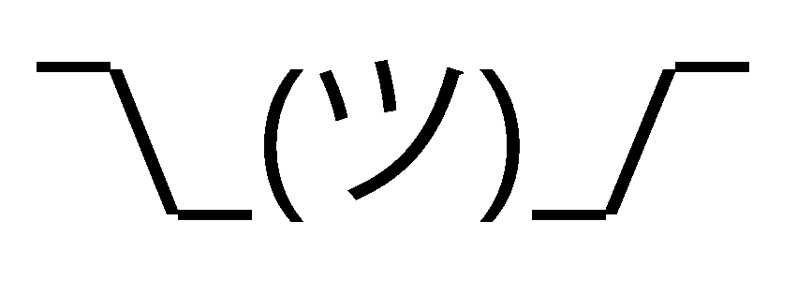
CS61B
Lecture 40: Wrapping Things Up
What We’ve Done: 61B in 12 minutes or less.
Moving Forwards.

Slide 3
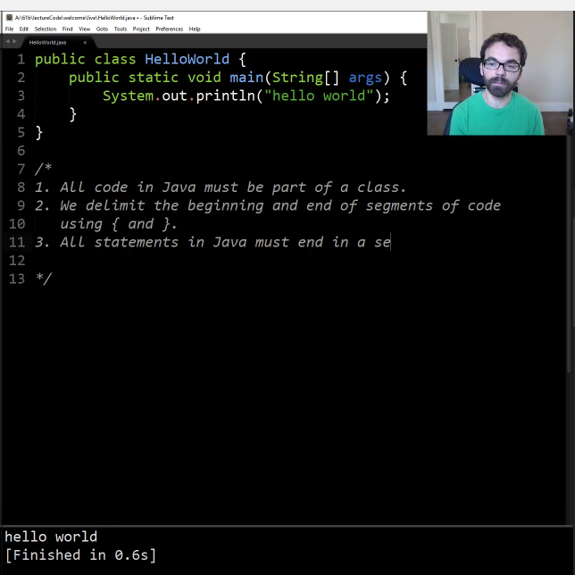
Where We Started
Just 14 weeks ago:

Slide 4
What We’ve Learned about Programming Languages
Object based programming: Organize around objects.
Object oriented programming:
Interface Inheritance.
Implementation inheritance.
Dynamic vs. static typing.
Generic Programming, e.g. ArrayList<Integer>, etc.
The model of memory as boxes containing bits.
Bit representation of positive integers.
Java.
Some standard programming idioms/patterns:
Objects as function containers (e.g. Comparators, IntUnaryFunctions).
Default method specification in interfaces (Link).
Iterators.
Example: Programmer only needs to know List API, doesn’t have to know that ArrayList secretly does array resizing.
Example: Array is a sequence of boxes. An array variable is a box containing address of sequences of boxes.

Slide 5
Important Data Structures in Java
Important data structure interfaces:
java.util.Collection (and its subtypes).
With a special emphasis on Map (and its subtypes).
Our own Collections (e.g. Map61B, Deque): Didn’t actually extend Collection.
Concrete implementations of these abstract implementations:
Examples: ArrayDeque implements Deque.

Slide 6
Mathematical Analysis of Data Structure/Algorithm Performance
Asymptotic analysis.
O(·), Ω(·), Θ(·), and tilde notation.
Worst case vs. average case vs. best case.
Exemplar of usefulness of average case: Quicksort
Determining the runtime of code through inspection (often requires deep thought).
Multiplicative resizing is much better than additive resizing (see midterm 2).
Multiplicative resizing results in Θ(1) add runtime for ArrayLists.
Additive resizing results in Θ(N) add runtime for ArrayLists.

Slide 7
Some Examples of Implementations for ADTs
Chaining HT
LinkedList
List
Resizing Array
Heap
Set
LinkedList
PQ
Balanced Tree
Resizing Array
Map
Ordered Linked List
Quick Find
BST (no balancing)
Quick Union
Red Black
DisjointSets
WeightedQuickUnionUF
B-Trees (2-3 / 2-3-4)
WQUPC
Adjacency Matrix
Trie and TST
Graph
Edge List
Heap
Adjacency Lists

Slide 8
Arrays vs. Linked Data Structures
Array-Based Data Structures:
ArrayLists and ArrayDeque
HashSets, HashMaps, MyHashMap: Arrays of ‘buckets’
ArrayHeap (tree represented as an array)
Linked Data Structures
Linked Lists
LinkedList, IntList, LinkedListDeque, SLList, DLList
Trees: Hierarchical generalization of a linked list. Aim for bushiness.
TreeSet, TreeMap, BSTMap, Tries (trie links often stored as arrays)
Graphs: Generalization of a tree (including many algorithms).
Tradeoffs of arrays vs. linked data structures.
Notes:
Write out code that inserts into a tree, for example. How find 5th largest, that sort of thing.

Slide 9
Tractable Graph Problems and Algorithms
Topological Sort
vertex ordering
Reachability
DFS Traversal
Bipartiteness
vertex markings
Discussed in section
Cycle Detection
BFS Traversal
Multiple Target
Shortest Paths by # of Edges
shortest paths tree
Prim’s
Minimum Spanning Tree
Minimum Spanning Tree
Kruskal’s
Multiple Target
Shortest Paths by Total Edge Weight
Dijkstra’s
shortest paths tree
DAGSPT
Single Target Shortest Paths by Total Edge Weight
shortest path
A*

Slide 10
Search-By-Key-Identity Data Structures:
2-3 Tree
Searches using compareTo()
Analogous to Comparison-Based
Set
RedBlack
Map
External Chains
Searches using hashCode() and equals()
Roughly Analogous to Integer Sorting
Linear Probing
Trie / TST
Searches by digit. Analogous to Radix Sorting
Comparison Based Sorting Algorithms: Ω(N log N) worst case
Radix Sorting Algorithms: Θ(NL) worst case:
(require a sorting subroutine)
Selection
If heapify first
Heapsort
Merge
LSD
Partition
Counting
MSD
Insertion
If store in helper BST, eq. to
Small-Alphabet (Integer) Sorting Algorithms: Θ(N) worst case
Counting

Slide 11
Fun/Weird Topics (This Week)
Compression:
Huffman Coding, and selection of data structures for Huffman Coding.
Other approaches: LZW and Run Length Encoding (extra slides).
Compression, Complexity, and P=NP:
Optimal compression is impossible.
Bounded space/time compression is possible if P=NP.
Allows you to find arbitrarily short programs that produce a given output in a given runtime.
Compression of a stream of bits might provide a useful model of that stream of bits (e.g. hugPlant.bmp -> hugPlant.java).
If P = NP, we could also solve all kinds of other interesting problems.

Slide 12
The Practice of Programming
Java syntax and idioms.
JUnit testing (and its more extreme form: Test-driven development).
Mining the web for code.
Debugging:
Identify the simplest case affected by the bug.
Hunt it down, giving it no place to hide.
With the right methodology, can find bugs even when finding bug through manual code inspection is impossible (see Horrible Steve in lab3).
Tactical vs. Strategic Programming.
Avoid information leakage. Build deep modules. Minimize dependencies. Minimize obscurity.
Real tools: IntelliJ, git, command line
Data structure selection (and API Design)
Drive the performance and implementation of your entire program.
Notes:
13 minutes of a rant

Slide 13
The Future

Slide 14
Your Life
Two interesting questions:
What am I capable of achieving?
What should I do with my life?

Slide 15
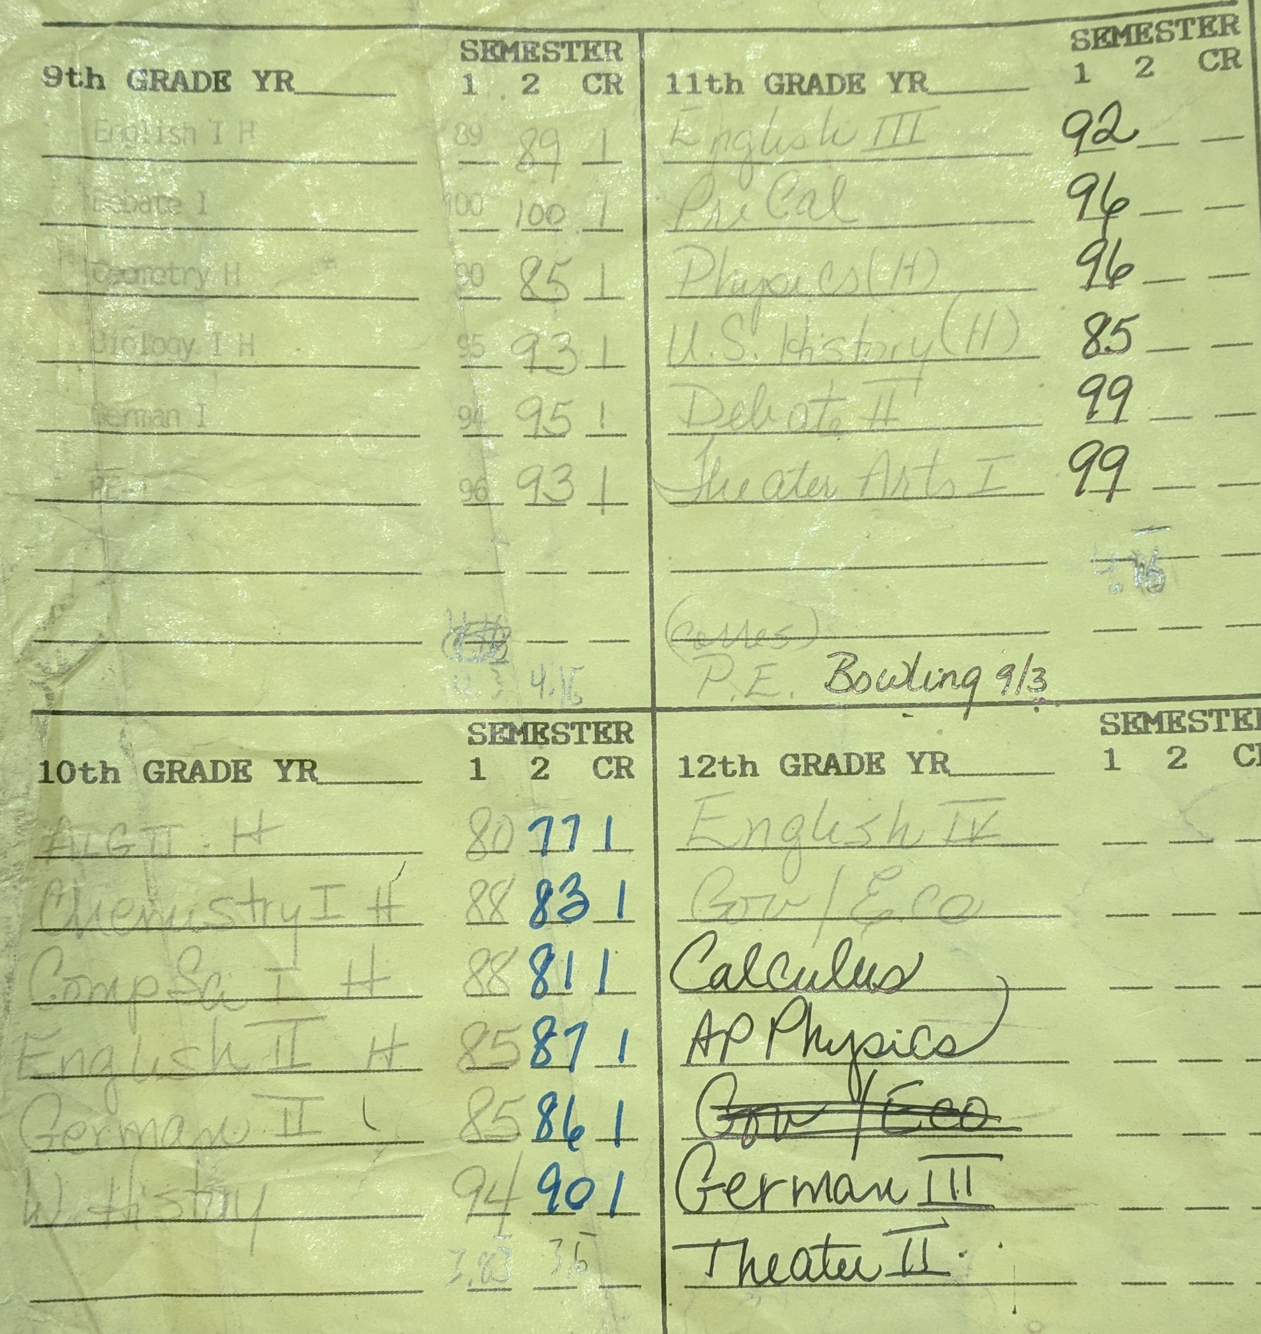
Some Josh Hug History

Slide 16
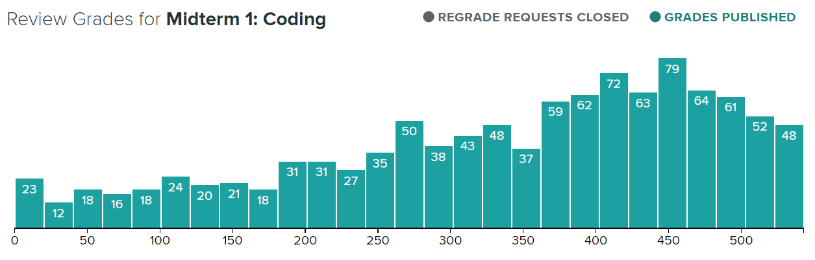

Midterm 1

Slide 17
Poll
To what degree do you believe the following statement: Nearly anybody enrolled at Berkeley could achieve an A in CS61B.
Assume they can spend the entire summer preparing beforehand, hire a tutor during the semester, etc.
Strongly disagree
Disagree
Neutral
Agree
Strongly agree

Slide 18
Growth vs. Fixed Mindset
Students can be thought of as having either a “growth” mindset or a “fixed” mindset (based on research by Carol Dweck).
“In a fixed mindset students believe their basic abilities, their intelligence, their talents, are just fixed traits. They have a certain amount and that's that, and then their goal becomes to look smart all the time and never look dumb.”
Perhaps most damningly, having to put in effort is a sign of weakness!
“In a growth mindset students understand that their talents and abilities can be developed through effort, good teaching and persistence. They don't necessarily think everyone's the same or anyone can be Einstein, but they believe everyone can get smarter if they work at it.”

Slide 19
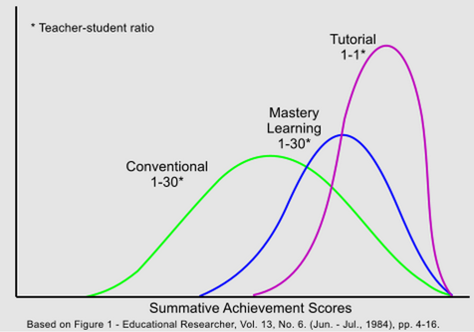
Bloom’s Two Sigma Problem
Bloom’s Two Sigma Problem: In one experiment, student randomly picked for 1-on-1 teaching performed similarly to the top 2% of a simultaneous lecture course.

Slide 20
A Supporting Experiment
In Sp16, I gave students the option to fail intentionally.
On average, students were 2.5 letter grades higher the second time, e.g. someone in the middle of the B range got an A the second time.
Possible interpretation: There exists some sort of preparation for 61B that helps students do much better.
Bottom line: You’re capable of achieving more than you might think possible.

Slide 21
Your Life
Two interesting questions:
What am I capable of achieving?
What should I do with my life?
You will be in high demand by everyone.
Your skills will enable you to affect the world, possibly profoundly.
Technology will continually to radically reshape the way we live our lives.

Slide 22
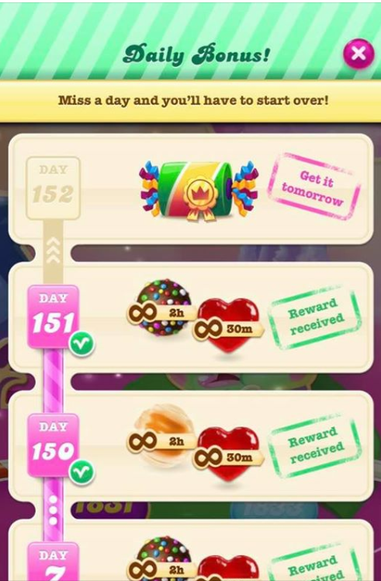
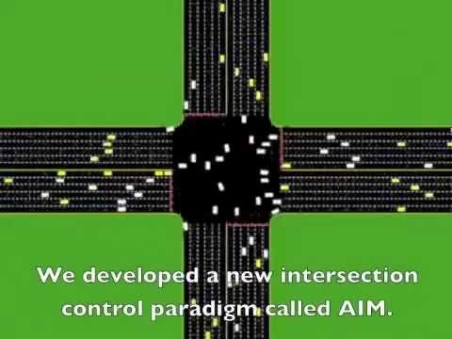
Choices (Yup)
How you use your skills is up to you.

Slide 23
Using Your Powers for Good
My request: Use your superpowers in a way that is a net positive for the lives of your fellow humans.
I’m not saying that you must work for relatively low wages to uplift the downtrodden (though that’d be great!).
…. but keep in mind that your work will profoundly affect the world.
(Wanna talk about this stuff more? Take CS195!)
Notes:
Josh: Does this seem surprising?

Slide 24
Questions About Anything?
Favorite class in HS: My government class. Just because our teacher was so good at getting us to do hard work and had really interesting perspectives.
Bowling? I took bowling so I didn’t have to P.E. My bowling class was correspondence. My best score ever was like a 150 or something
In middle school, joined the science magnet program at Seabrook Intermediate School primarily because it only required 1 rather than 2 semesters of P.E.
What do I think about blockchain?
I think it’s conceptually cool, but my gut feeling is that it is not useful. But I’m not sure, I’m no expert. Nick Weaver has corrupted me into believing blockchain is generally not useful.

Slide 25
Questions About Anything?
Hang out with students?
Sure, but kinda weird. I feel more OK if you’ve graduated. But I have hung out with my TAs from time to time.
I’ll get lunch sometime, just catch me by email (good luck).
How did we develop Prairie Learn?
Someone at University of Illinois
Least favorite 61B topic: Dynamic Method Selection

Slide 26
Course Reflections

Slide 27
Reflection on the Course: New for Fall 2020
New 61B features since last time I taught 61B (Spring 2019):
15 slip days plus 2 amnesty days.
Online exams with PrairieLearn.
No partners for NBody.
gitbugs.
Snaps plugin.
Live coding at the end of labs.
All the online-teaching tools (Zoom, Discord).
Much improved beacon.datastructur.es.
Use of Ed instead of Piazza.
More formal instruction on how to do correctness and timing tests (especially in the brand new lab 5).
New conceptual HW3.
Fewer labs and optional lectures.

Slide 28
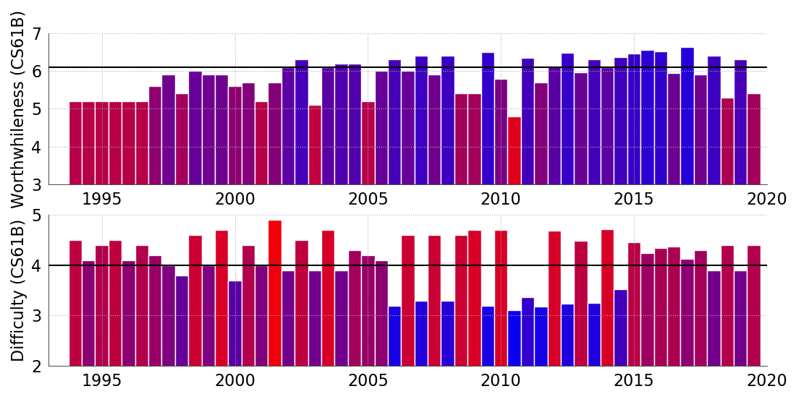
On the Subject of Difficulty: 61B History (black line is Fa18 61A)
* is a josh semester
*
*
*
*
*
*
*
*
*
*

Slide 29
Spring 2021: Things For Next Time
Major possibilities:
Move straight to IntelliJ from day 1.
Rebrand NBody from proj0 to hw1.
Make project 2 into more of a design project.
The TAs tell me Spring 19 and Fall 20 proj2a/2b/2c (KdTree, MinPQ, A*) didn’t give you enough freedom to make interesting choices.
More proactively help students find community / study groups.
Maybe also: Convert project 3 so that it runs in real time and allows you to join other peoples games, i.e. multiplayer.
Let me know what else you might want to see on post-final exam survey.

Slide 30
Any Questions About Course Structure?

Slide 31
Closing Thoughts
It is a terrifying and awesome responsibility to decide how you should spend hundreds of your precious hours here at Berkeley.
I do this job because I want you to live more fulfilling lives.
I hope I’ve done a good job. I know it wasn’t perfect (and sadly never will be).
… and thanks for all the kind words, feedback, and understanding when things are not as good as they could be.

Slide 32
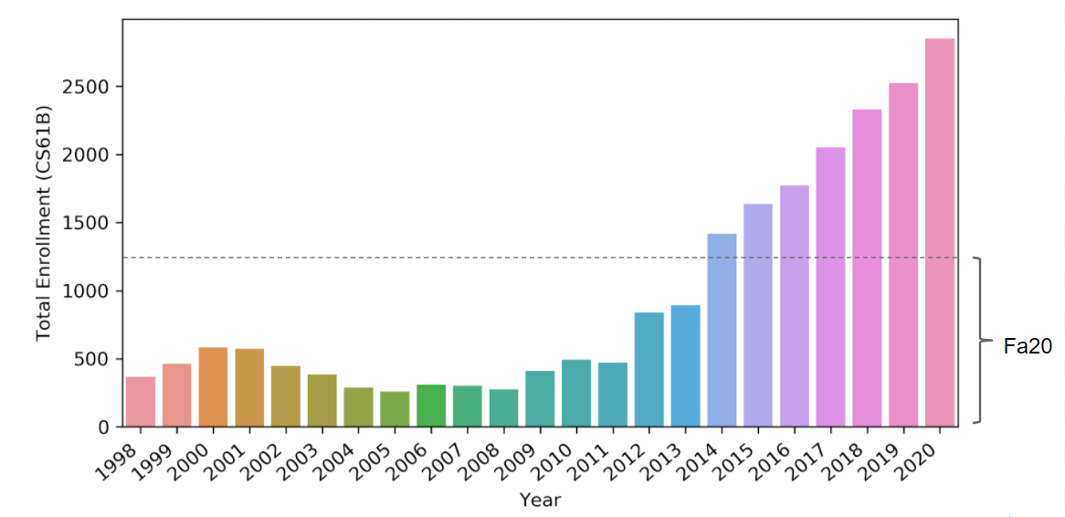
61B Needs You Next Spring
Academic interning: Learn more, help others, get units, maybe become a GSI.
Watch out for an announcement on the Fall 2020 61B Ed.

Slide 33
Snaps
Reminder: If you’d like to help out with the Snaps research project, please push your repo and fill out the form.
https://us.edstem.org/courses/979/discussion/188174

Slide 34
Special thanks to the staff, without whom we would all be on fire.
Full time GSIs: Akshit Annadi, Alex Schedel, Anjali Kantharuban, Arjun Sahai, Connor Lafferty, Itai Smith, Omar Khan, Shivani Kishnani, Sohum Hulyalkar
Part time GSIs: Ada Hu, Adel Setoodehnia, Allyson Park, Boren Tsai, Chirasree Mandal, Claire Ko, Eric tang, Eric Zhu, Ethan Mehta, Fatema Yasini, George Zhou, Henry Kasa, Henry Maier, Isabelle Zhou, Linda Deng, Robin Qiu, Romain Priour, Ryan Tseng, Sara Reynolds, Sarah Liu
Tutors: Ayush Sehgal, David Shau, Jack Wang, Jacob Haddad, Shriya Nandwani, Joshua Blanchard, Saad Jamal, Shreyas Kompalli
Academic Interns: Kyle Yu, Shilpi Shah, Justin Chen, Saikumar Gantla, Hannah Moore, Matthew Yu, Xinyu Fu, John Lee, Olivia Huang, Michael Wang, Yuwen Zhang, Tanya Sarkin Jain, Jeffrey Fan, Taewoo Han, Daniel He, Curie Park, Justin Lin, Emi Tran, Ethan Wu, Jeffrey Shen, Emily Su, Helen Hoang, Violex Ming, Smeet Patel, Anish Gollakota, Shreya Khandewale, Pranav Sukumar, Amritansh Saraf, Aekus Bhathal, Michael Paller, Tiffany Mao, Kyle Zhang, Sean Kim, Hana Lee, Angela Chen, Kishore Kumar, Noor Mahini, Ashley Auduong, Megan Yu, Rohit Mehta, Seraph Woodbury, Tejvir Jogani, Connor Lien, Michelle Chen, Rohan Khandelwal, Ramanan Abeyakaran, Richard Chang, Shefali Goel, Kenneth Ian Shyle, Nishant Patwardhan, Kuhu Sharma, Suraj Pakala, Marcus Hong, Ella Schwarz, Srinidhi Sankar, Brandon Marin-Mares, Kaaviya Sasikumar, Reena Yuan, Alexandra Lu, Ahmed Baqai, Surya Sunkavelli, Nandini Singh, Emma Toon, Farhad Alemi, Elise Ong, Brianna Fan, Kavya Marrapu, Anik Gupta, Anne Nguyen, Tarun Amarnath, Dennis Mach, Abhiraam Wadekar, Tiffany Kim, Aniruddh Chennapragada, Boxi Fu, Amrita Rajan, Jonah Noh, Aniruddha Vangala, Aryan Agrawal, Deepak Ragu, Eve Lin, Sakshi Satpathy, Spencer Jenkins, Ryan Huang, Yuanhan Li, Shreyas Kompalli, Derwin Wu, Avyakth Challa, Anton Zabreyko, Vincent Hwang, Arin Chang, Ishaan Mauli Mishra, Tu (Alina) Trinh, Eugene Kim, Jonathan Yun

